Slide 1
Recitation 6
Mini lecture

Slide 2
Announcement
Mid-term exam will be (or were) covered by this week’s lecture
Deadline for Recitation 6 – 10 days (72 hrs + a week)

Slide 3
Outline
Part 1: Review - Matrix
Part 2: Problem #1 – Matrix Coordinate
Part 3: Problem #2 – Image and Matrix

Slide 4
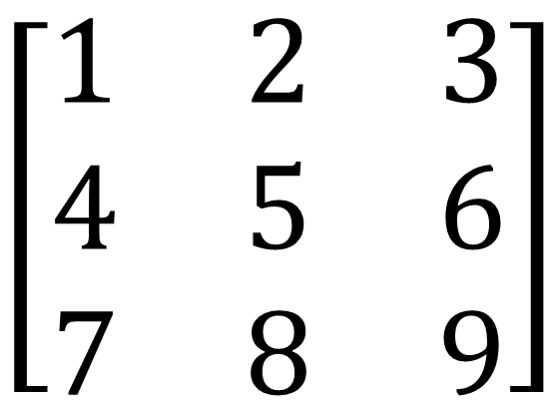
Matrices
Matrices
Syntax: Commas and spaces to separate horizontal numbers, semicolons for vertical separation
x = [1 2 3; 4 5 6; 7 8 9];
Always go horizontal before vertical
$$\left[\begin{matrix}1 & 2 & 3 \\ 4 & 5 & 6 \\ 7 & 8 & 9\end{matrix}\right]$$

Slide 5
Indexing Matrices
Matrices
Indexing Elements
x = [1 2 3; 4 5 6; 7 8 9];
Syntax: x(vertical position, horizontal position)
$$\left[\begin{matrix}1 & 2 & 3 \\ 4 & 5 & 6 \\ 7 & 8 & 9\end{matrix}\right]$$
x(1,1)
x(3,2)
x(2,3)

Slide 6
Problem #1 – Matrix Coordinate
Remember
Matrix(yDirection, xDirection)
Start with function
Two for loops

Slide 7
Matrix Indexing
When performing operations on large matrices, often it is useful to create a simple test case (smaller matrix)
Easier to think about
Come up with specific solution
See how it generalizes
Which indices become which indices when you’re trying to flip a 3x3 matrix 180 degrees?

Slide 8
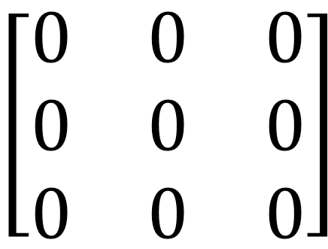
Class Example - Nested Loops and Matrices
x = zeros(3,3) % Creates a 3x3 matrix of 0s
%You can’t “Grow” matrices like you can arrays, you %need to pre-allocate and then assign values
for horizontal = 1:1:3
for vertical = 1:1:3
x(vertical,horizontal) = vertical*horizontal;
end
end
$$\left[\begin{matrix}0 & 0 & 0 \\ 0 & 0 & 0 \\ 0 & 0 & 0\end{matrix}\right]$$
horizontal == 3
vertical == 3

Slide 9
Problem #2 – Image and Matrix
Can get the dimensions using “size”
[xdimension, ydimension) = size(matrix)

Slide 10
Importing color image, converting to grayscale
Save image in MATLAB folder
filename = %A string with the file’s name, like ‘doge.jpg’
myImage = imread(filename);
myImage = rgb2gray9myImage;
imshow(filename)
rgb (red, green, blue)

